Slide 1
FY20 quality case（Red paper）summary

Slide 2
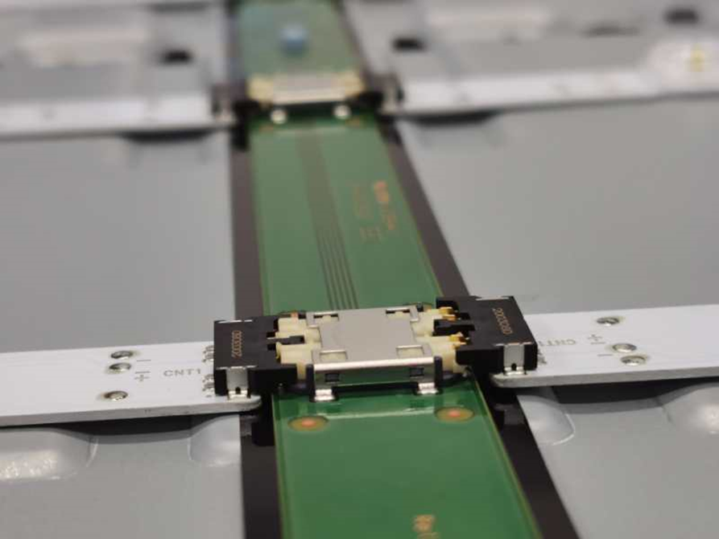
【Market】 20200616/01--NX85 无法开机，灯闪4下
Problem Details（不良症状） |  |  |  | Red paper NO. | PIC
TV can not turn on, LED 4x blinking |  |  |  | 20200616/1 | Yang
problem Detail |  |  |  | Occurred Date | Quantity
CNT not insert well |  |  |  | 2020/06/15 | 1
Customer Status |  |  |  | FA Date | Parts
DOA, exchange set OK |  |  |  | 20200615 | CNT
S/N NO. | Model | SSV line | shift | Found Plant | Stage
1402183 | KD-85X9000H | S3 | 早 | SSVE | Market
Pictures（写真）
NG:CNT浮起
OK
Progress Log
Action（改善対策） | Task Progress（内容詳細） | PIC: | Target | Status
1. Define the problem（定义问题） | 制造装配不良 (Assembly issues) | PE/QA | 20200615 | Close
2. Define & verify root cause （真因） | LS基板CNT未完全装入，疑似整机运输后排插跳出(CNT not insert well, float after logistic) | Xuhui | 20200618 | Close
3. Short-term corrective action （暫定対策） | 开始对策机号 1405369，LS基板安装后追加按压确认，后工位LS扫描确认顶部的排插，LS点灯确认顶部排插 (after insert, press it) | Xuhui | 20200618 | Close
4. Permanent Corrective Action （恒久対策） | 所有同类型排插，横向展开至各机种实施按压动作确认；按压作业追加入作业手顺书中 Expand to all models, add press operation to SOP | Xuhui Panyunfen | 20200618 | Close

